Slide 2
a. severe
v. announce
adv. privately
v. reject
v. spin, spun, spun
v./n. suspect
n. victim
n. outbreak
n. physician
v. attend
v./n. defeat
v. contribute
v. infect
v. analyse
a. scientific
16. n. characteristic
17. n./a. expert
18. n. enquiry
19. v. investigate
20. a. deadly
21. be enthusiastic about
22. be cautious about
23. make sense
24. put forward
25. expose … to
26. link … to
27. draw a conclusion
28. be strict with
29. at times
30. look into

Slide 3
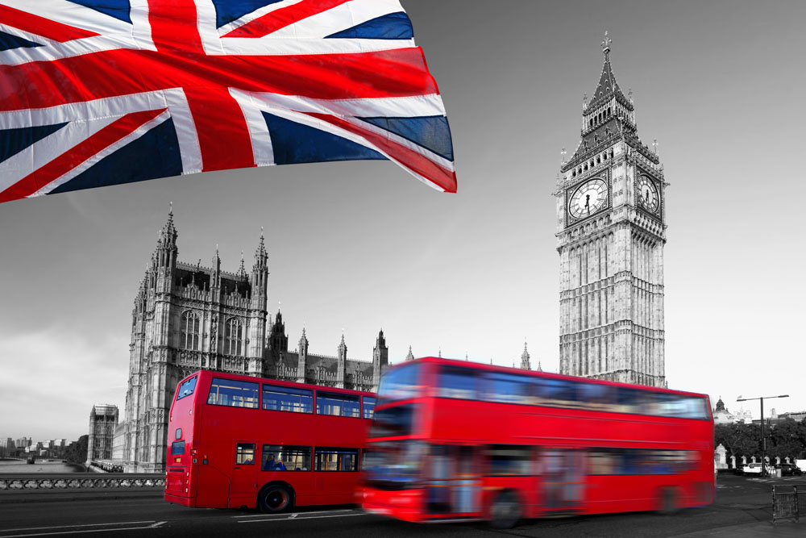
The United Kingdom

Slide 4
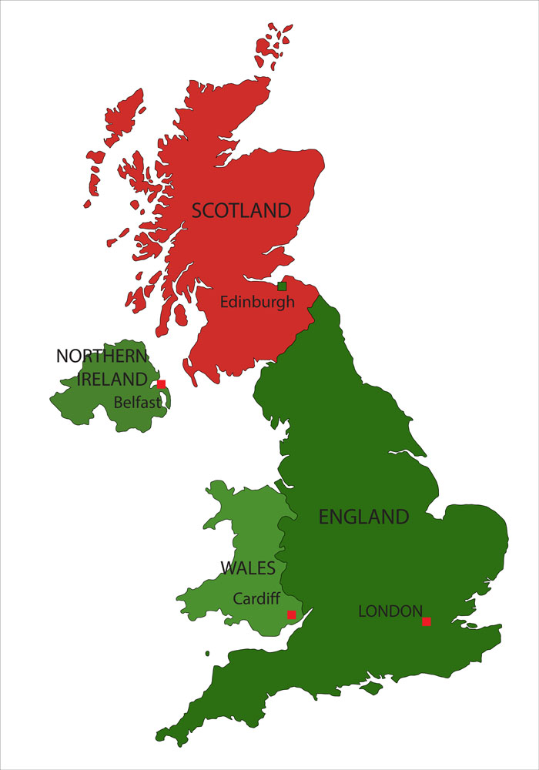
the composition of the UK
the United Kingdom is made up of:
The countries that make up Great Britain are：
If we speak of England, we mean:
What is different in the four countries?
England, Wales, Scotland, the Northern Ireland
England, Wales, Scotland
England, Wales
institution, educational system, different teams in spots games…

Slide 5
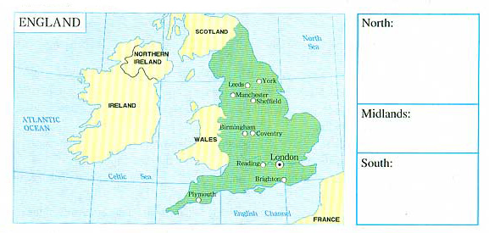
the division of England
York
Leeds
Manchester
Sheffield
Birmingham
Coventry
Reading
Brighton
Plymouth
London

Slide 6
the historical treasure: London
Why London is important?
What is London famous for?
What are the groups of invaders and their influence?
It is the cneter of government and its administration.
museums, art collections, theatres, parks, buildings
Romans – towns and roads
Anglo-Saxons – language and government
Vikings – vocabulary and place-names of the North of England
Normans – castles and words for food

Slide 7
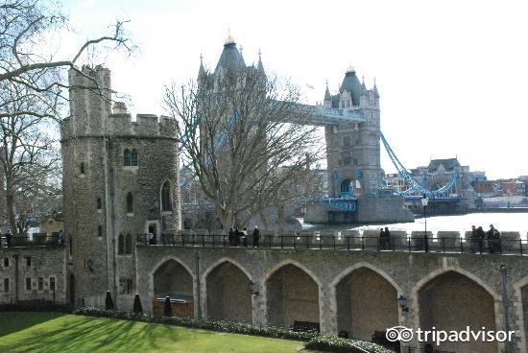
sightseeing in London – day one
Tower of London
used to be part of a royal palace and prison combined

Slide 8
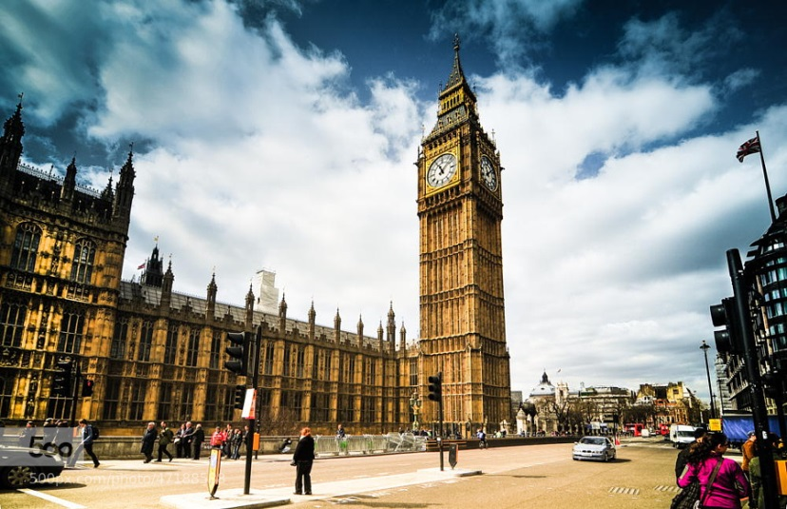
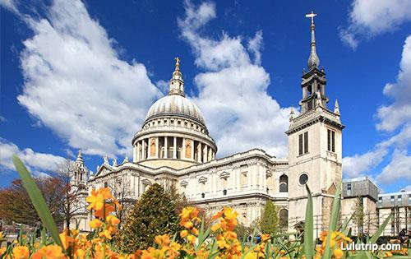
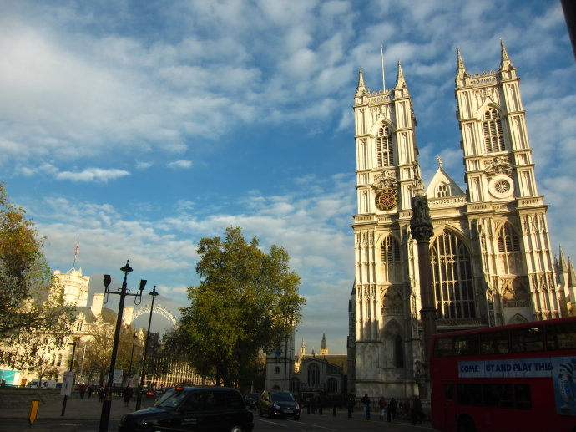
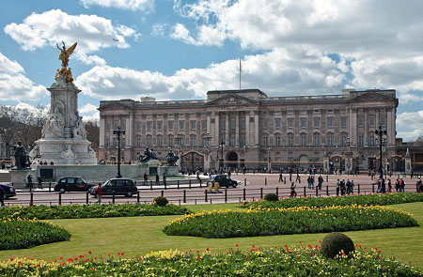
sightseeing in London – day one
St. Paul’s Cathedral
Big Ben
Westminster Abbey
Buckingham Palace

Slide 9
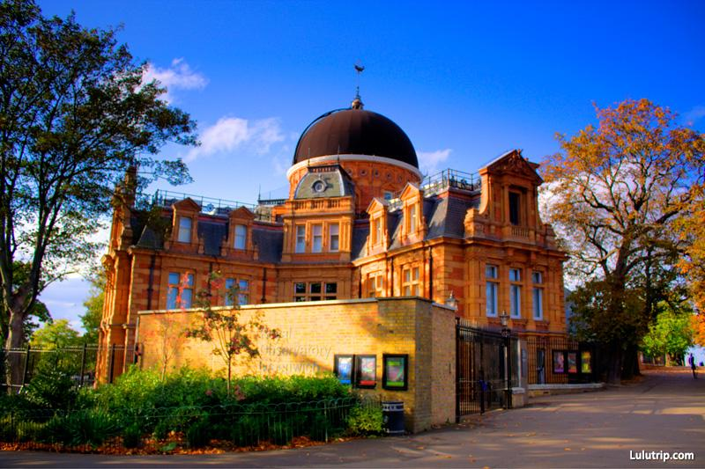
sightseeing in London – day two
Greenwich Observatory
imaginary line dividing the eastern and western halves of the world

Slide 10
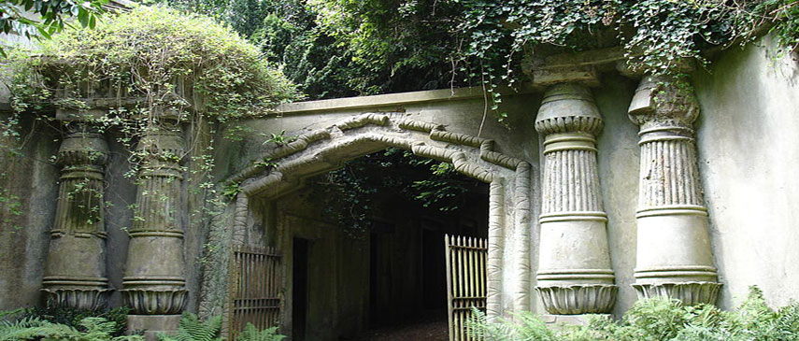
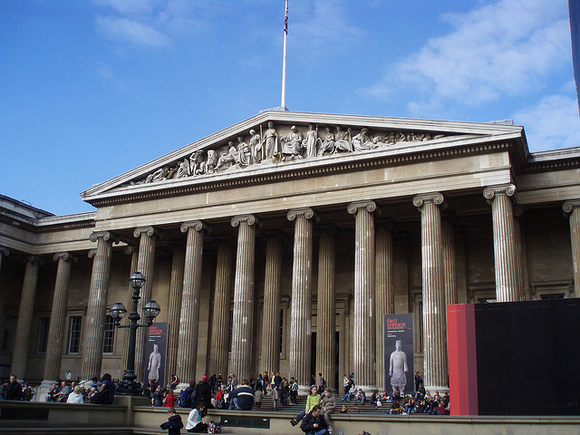
sightseeing in London – day three
Highgate Cemetery
Karl Marx’s statue
British Museum

Slide 11
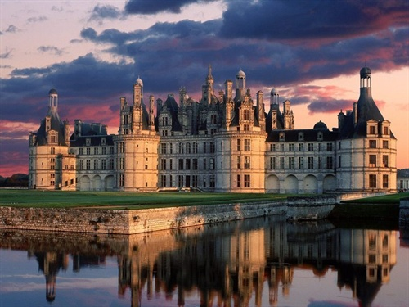
the next destination
Windsor Castle

